Slide 1



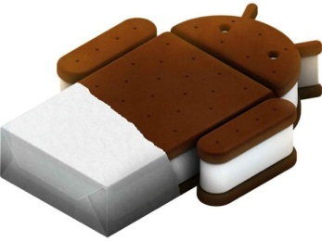

Programming with Android: Activities
Luca Bedogni Marco Di Felice
Dipartimento di Scienze dell’Informazione
Università di Bologna
Notes:
1
1

Slide 2
Activity
Outline:
What is started by the device
It contains the application's informations
Has method to answer certain events
An application could be composed of multiple activities

Slide 3
Creating an activity
Create a class that is a subclass of Activity
Implement callback methods
OnCreate():
Initialize
SetContentView()

Slide 4
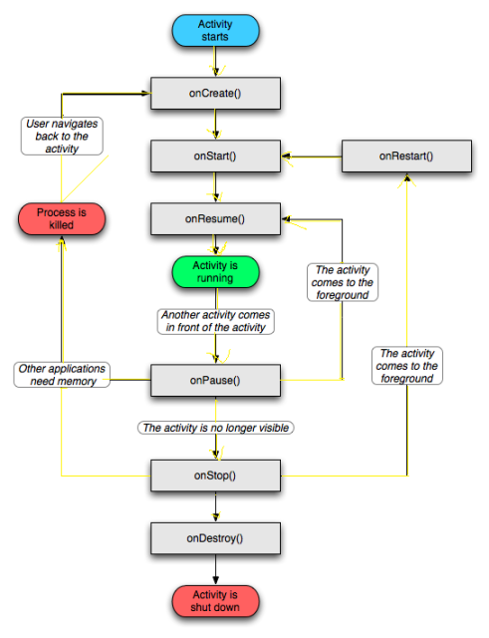
Activity lifecycle

Slide 5
Activity lifecycle
OnCreate()
Called when the activity is created
Should contain the initialization operations
Has a Bundle parameter
If onCreate() succesfull terminates, it calls onStart()

Slide 6
Activity lifecycle
OnStart()
Called when onCreate() terminates
Called right before it is visible to user
If it has the focus, then onResume() is called
If not, onStop() is called

Slide 7
Activity lifecycle
OnResume()
Called when the activity is ready to get input from users
Called when the activity is resumed too
If it succesfully terminates, then the Activity is RUNNING

Slide 8
Activity lifecycle
OnPause()
Called when another activity comes to the foreground, or when someone presses back
Commit unsaved changes to persistent data
Stop cpu-consuming processes
Make it fast

Slide 9
Activity lifecycle
OnRestart()
Similar to onCreate()
We have an activity that was previously stopped

Slide 10
Activity lifecycle
OnStop()
Activity is no longer visible to the user
Could be called because:
the activity is about to be destroyed
another activity comes to the foreground

Slide 11
Activity lifecycle
OnDestroy()
The activity is about to be destroyed
Could happen because:
The systems need some stack space
Someone called finish() method on this activity
Could check with isFinishing()

